Slide 1

How to Write a Scientific Paper
Prof. Quazi Tarikul Islam
FCPS, FACP, FRCP(Glasg), FRCP(Edin)
Professor of Medicine
Popular Medical College

Slide 2
Introduction

Slide 3

Introduction
Research is a quest for knowledge through diligent search or investigation or experimentation aimed at the discovery and interpretation of new knowledge
In medical profession to be a competent, one must keep him update, needs new articles to read and also to know how to write.

Slide 4
Dissertation/ Thesis
Definition:
“A treatise advancing a new point of view resulting from research; usually a requirement for an advance academic degree”.
www.word reference.com

Slide 5
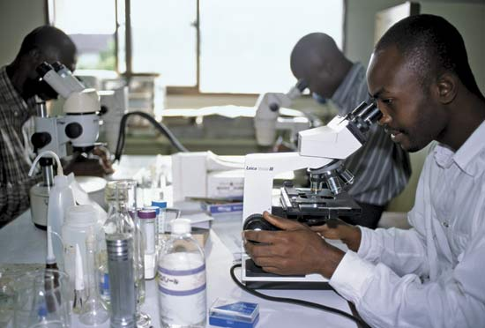
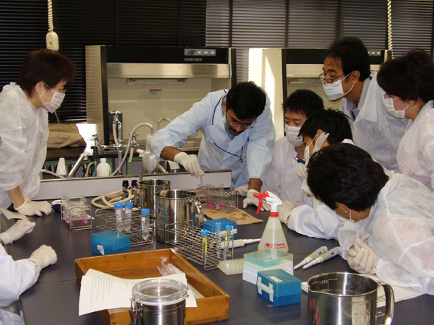

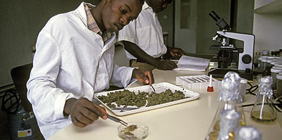

Slide 6
Overview

Slide 7
Overview
Task of writing a research paper can be daunting
Even with groundbreaking research, unless the paper is correctly written:
  at best, publication will be delayed
  at worse, never published
Presentation will provide an overview of ‘how to write a well-structured research paper for publication’

Slide 8
Background: Author’s Perspective
Motivation to publish:
  Dissemination (54% 1st choice)
  Career prospects (20% 1st choice)
  Improved funding (13% 1st choice)
  Ego (9% 1st choice)
  Patent protection (4% 1st choice)
  Other (5% 1st choice)
Bryan Coles (ed.) The STM Information System in the UK, BL Report 6123, Royal Society, BL, ALPSP, 1993

Slide 9
Author Publishing Priorities
Quality and speed
  Top items were
    Refereeing speed
    Refereeing standard
    Journal reputation
Editor/board, physical quality and publication services

Slide 10
Author versus Reader Behaviour
Author behaviour
  Want to publish more
  Peer review essential
  Other journal functions crucial
  Wider dissemination
Reader behaviour
  Want integrated system
  Browsing is crucial
  Quality information important
  Want to read less
Elsevier study of 36,000 authors (1999-2002) presented by Michael Mabe at ALPSP Seminar on “Learning from users” 2003; www.alpsp.org

Slide 11
Reader’s priorities
Authoritative quality articles
Ease of access
Rapid delivery
Convenient format
Linking of information - clustering
Low or no cost
Up-to-date information

Slide 12
Differences: Authors and Readers
Authors are journal focused
Readers are article focused
Publish more/read less dichotomy

Slide 13
Key Elements of Publishing
Ethical Issues
Style and language
Structure of paper
Components of paper
Article submission/journal selection
Publisher’s process/peer review

Slide 14
Ethical issues
Informed voluntary consent of study subject is absolutely essential
  Should be able to exercise free power of choices without any force, fraud, deceit---or coercion
Medical research should only be conducted if the importance of objective outweighs the inherent risks and burden to the subject
Ethical clearance from IRB is mandatory

Slide 15
Structure of a Paper
Scientific writing follows a rigid structure –
a format developed over hundreds of years
Consequently, a paper can be read at several levels:
  Some people just will refer to the title
  Others may read only the title and abstract
  Others will read the paper for a deeper understanding

Slide 16
Types of Medical Writing
Editorial
Original Article
Review Articles
Thesis/Dissertation
Short Papers
Case Reports
Letter to Editor
Personal Views
Special Communication

Slide 17
Components

Slide 18
Components of a Paper

Slide 19
Components of a dissertation/thesis
The front matter
Introduction
Literature Review
Methods
Results
Discussion
Conclusion(s)
Recommendation(s)
References
Appendices

Slide 20
The front matter
Title page
  Title, author, institution and year
Declaration by the Researcher
Supervisor’s Certificate
Acceptance page (Signature page)
Dedication (Optional)
Abstract
Table of contents
List of Tables and List of Figures
Acknowledgement

Slide 21
Steps of writing

Slide 22
Steps of writing medical article
Before start writing
Writing the article
Making the article to be published

Slide 23
Why an article is published?
It says something new : ORIGINAL
It is well plotted : SIMRAD
It was timely sent to the appropriate publication : “MARKETED”
Block I. Before start writing

Slide 24

Block I. Before start writing

Slide 25

Block I. Before start writing

Slide 26
What we need to have in an article?
Knowledge
Norms of publication
Hardware and software
Matter
Block I. Before start writing

Slide 27
Knowledge
Norms of publication
Hardware and software
Matter
Block I. Before start writing

Slide 28

Literature Review
To understand:
How other scholars have written about your topic.
The range of theories used to analyze materials or data
How other scholars connect their specific research topics to larger issues, questions, or practices within the field.
The best methodologies and research techniques for your particular topic.

Slide 29
Literature review
Limited to the state of the art relevant to your thesis. The idea is to present (not analyze) the major ideas in the state of the art right up to, but not including, your own personal brilliant ideas.
organize this section by idea, and not by author or by publication

Slide 30
Knowledge
 Select a group of journals of interest and read them
periodically - Updated
- “Get the tempo”
 For General Internal Medicine:
- NEJM
- BMJ
- Arch Int Med
- Med Clin
Block I. Before start writing

Slide 31
 To know how to perform an up-to-date
 Are you really discovering anything new?
“State of the Art”
Block I. Before start writing

Slide 32
Give overview of a topic; print textbooks,
electronic textbooks, narrative reviews in
Journals
i) Harrison’s Online
ii) Scientific American Medicine Online
iii) MD Consult
iv) Medline articles
    a. Ovid
    b. PubMed
Block I. Before start writing

Slide 33
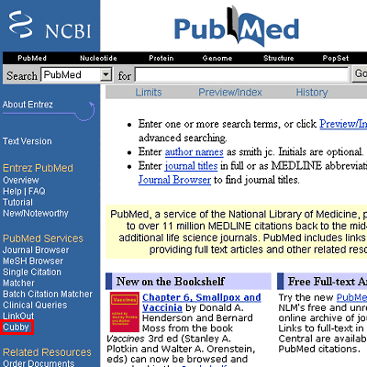

Slide 34
Knowledge
“It is concise, usually uses the passive form. The asseverations are based on other articles published. The conclusions are based on the results of the study”
“Inductive thinking”
Block I. Before start writing

Slide 35
Knowledge : Example
“The situation with respect the subject A is 1(references of bibliography)…We have done a study to clarify the point B which was not clear. To do it, we have measured the parameters C, D and F with the device G. The results were that C had a value of 2, D had a value of 3, and F had a value of 4. We conclude that the point B has been cleared…”
Block I. Before start writing

Slide 36
Knowledge
Norms of publication
Hardware and software
Matter
Block I. Before start writing

Slide 37

Norms of publication
 Make a list of “target journals”
 Make a folder with the norms of
publication of your “target journals”
Block I. Before start writing

Slide 38
Knowledge
Norms of publication
Hardware and software
Matter
Block I. Before start writing

Slide 39

☑ PC
☑ Internet
☑ Word processor
Block I. Before start writing

Slide 40
Knowledge
Norms of publication
Hardware and software
Matter
Block I. Before start writing

Slide 41
Matter
 Clinical case
 Series of clinical cases
 Observational study
 Trial - Randomized
- Non randomized
 Review
 Metanalysis
 Opinion
Block I. Before start writing

Slide 42
We are ready to start writing
We have an interesting subject
We know this finding had not been published before
We have a state of the art vision of the matter
We have a word processor and a web link
Lets Start Writing!
Block I. Before start writing

Slide 43
Before start writing
Writing the article
Making the article to be published

Slide 44
Tips for writing up
Prefer short sentences and paragraphs
Never use a foreign, slang, or jargon word unless there is no equivalent in everyday English
Punctuate sparingly
Never use an exclamation mark except for the purposes of quotation
Write in an objective way - be impersonal.

Slide 45
Example of time schedule
Activity | 1st | 2-10 | 11 | 12
Phase 1 Literature review Development of questionnaire Pretesting
Phase II Data collection

Slide 46
 | 11 | 12
Phase III Data entry, edit& Data analysis
Phase IV report writing Submission

Slide 47
Author listing

Slide 48
Authors Listing
ONLY include those who have made an intellectual contribution to the research
OR those who will publicly defend the data and conclusions, and who have approved the final version
Order of the names of the authors can vary from discipline to discipline
  In some fields, the corresponding author’s name appears first

Slide 49
The Basic Structure of Article
TITLE
(S) Summary (Structured Abstract)
(I) Introduction (What Question was asked?)
(M)Methods (How was it Studied?)
(R) Results (What was Found?)
(A) Analysis (How data was analysed?)
(D) Discussion (What Do the Findings Mean?)
Acknowledgements
Bibliography/References
Block II. Writing the article

Slide 50
Title

Slide 51
Title
One of the most important items to publish an article. It has to have “catch up”
 Should be specific but comprehensive
 Short but sufficiently descriptive
 No abbreviations
Block II. Writing the article

Slide 52
Title
Describes the paper’s content clearly and precisely including keywords
Is the advertisement for the article
Do not use abbreviations and jargon
Search engines/indexing databases depend on the accuracy of the title - since they use the keywords to identify relevant articles
Type the Title using capitals for the first letter of each word excepting the articles (a, an, the) and prepositions (in, of, on,etc)

Slide 53
Title
Should avoid---a study of----
e.g. Maternal and fetal outcome in premature rupture of membranes- A clinical study in BSMMU and DMCH.
Common faults are
  Too short–
  e.g “Fever and Jaundice”
“A study of Vit D3 level”

Slide 54
Abstract

Slide 55
Structured Abstract / Summery
 Overview of the work
 Methods
 Highlights of the results
 General statement of significance
 Conclusions
 Key words
Block II. Writing the article

Slide 56
Abstract
Briefly summarize (often 150 words) - the problem, the method, the results, and the conclusions so that
  The reader can decide whether or not to read the whole article
Together, the title and the abstract should stand on their own
Many authors write the abstract last so that it accurately reflects the content of the paper
See: The Structured Abstract: An Essential Tool for Research
http://research.mlanet.org/structured_abstract.html

Slide 57
Abstract and summary are synonymous
Should state every aspect of the dissertation in a nutshell
  Should be structured
    Introduction (why the study ?)
    Method(How, where, whom, when?
    Results( principle and significant findings)
    Conclusion
  Every subheadings In separate paragraph.
  Usually in single page
  Placed at center of the page

Slide 58
Introduction of Article

Slide 59
Introduction for article
 Background information, existing
state of knowledge
 Review of the work of others
 Rationale for present study
 Give pertinent references
Block II. Writing the article

Slide 60
Introduction for article
Clearly state the:
  Problem being investigated
  Background that explains the problem
  Reasons for conducting the research
Summarize relevant research to provide context
State how your work differs from published work

Slide 61
Introduction for article
Identify the questions you are answering
Explain what other findings, if any, you are challenging or extending
Briefly describe the experiment, hypothesis(es), research question(s); general experimental design or method

Slide 62
Contents of Introduction
The Background or context of the problem
The Rationale
Research question(s) or Hypothesis
Objectives
  Use action verbs
  Should be Specific, measurable, achevable and Time Bound
  Rationale

Slide 63
Introduction for article
Should describe
What has already been done?
  Review of Literature should be relevant to the topics
Why the work is important?
  statement of the problem and significance
What the student intend to do?
  Research question or the specific hypothesis
  the rationale for the study
State the aim (s) and objective (s)
  of the study

Slide 64
Introduction for article
Use present Tense for the statements that are currently true. Use Past Tense for findings of work done before
Avoid using I or We and write in third person and passive voice

Slide 65
Introduction for article
It has the aim of giving a brief vision of the state-of-art of the matter and justifying the study.
“The situation about the matter is A.....There is a blank of the knowledge with respect to B......so...we did C”
All the asseverations will have to be supported by bibliographical references
Block II. Writing the article

Slide 66
Example: Introduction
Rheumatoid arthritis is a systemic autoimmune disease that affects approximately 1 percent of the adult population.¹ It is characterized by chronic inflammation in the synovial membrane of affected joints that ultimately leads to loss of daily function due to chronic pain and fatigue. The majority of patients also have deterioration of cartilage and bone in the affected joints, which may eventually lead to permanent disability. Rheumatoid arthritis is associated with increased morbidity and mortality.²
Block II. Writing the article

Slide 67
Example: Introduction (Cont.)
Although the precise pathogenesis of rheumatoid arthritis remains unclear, it has been postulated that multiple exogenous or endogenous antigenic triggers, or both, act in the presence of a background genetic predisposition to initiate a self-perpetuating series of autoimmune responses in the synovial compartment.^{3,4} Many cell populations, including monocytes, macrophages, B cells, T cells, endothelial cells, and fibroblasts, participate in the ongoing inflammatory process.³ The precise contribution of B cells to the immunopathogenesis of rheumatoid arthritis is not fully understood, although a number of mechanisms have been proposed.^{5,6,7} However, strong evidence for a critical role of B cells in rheumatoid arthritis came from a small open-label study of rituximab in combination with cyclophosphamide and corticosteroids.⁷
Block II. Writing the article

Slide 68
Study design

Slide 69
Descriptive
Basic study designs
Explanatory
Document & communicate experience: share ideas, programs, treatments, unusual events & observations. Begin search for explanations
Examine etiology, cause, efficacy, using the strategy of comparisons
Experimental
Observational
Evaluation of therapeutic, educational, administrative interventions
Etiologies, predictors, better diagnosis
Examples:
• Case report or series
• Population
• Clinical series
• Program or course
Examples:
• Case control
• Follow up / cohort
• Cross sectional
Examples:
• Clinical trial
• Educational intervention
• Health care trial

Slide 70
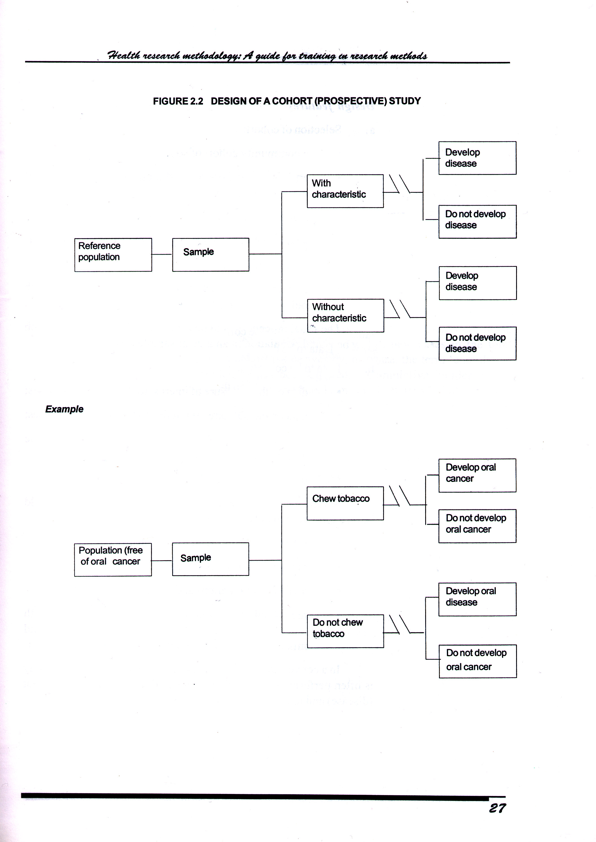
Design of a Cohort (prospective) Study

Slide 71
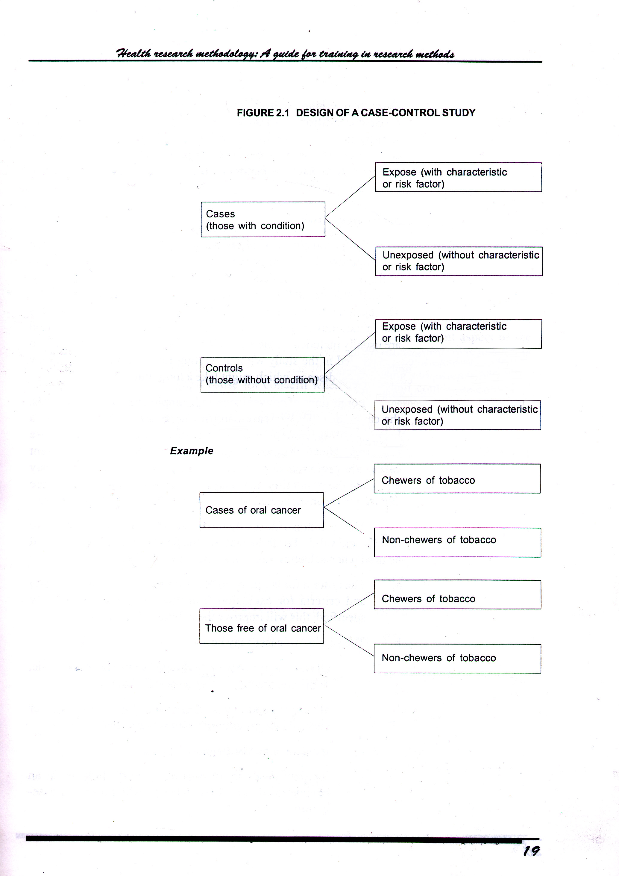
Design of a Case-Control Study

Slide 72
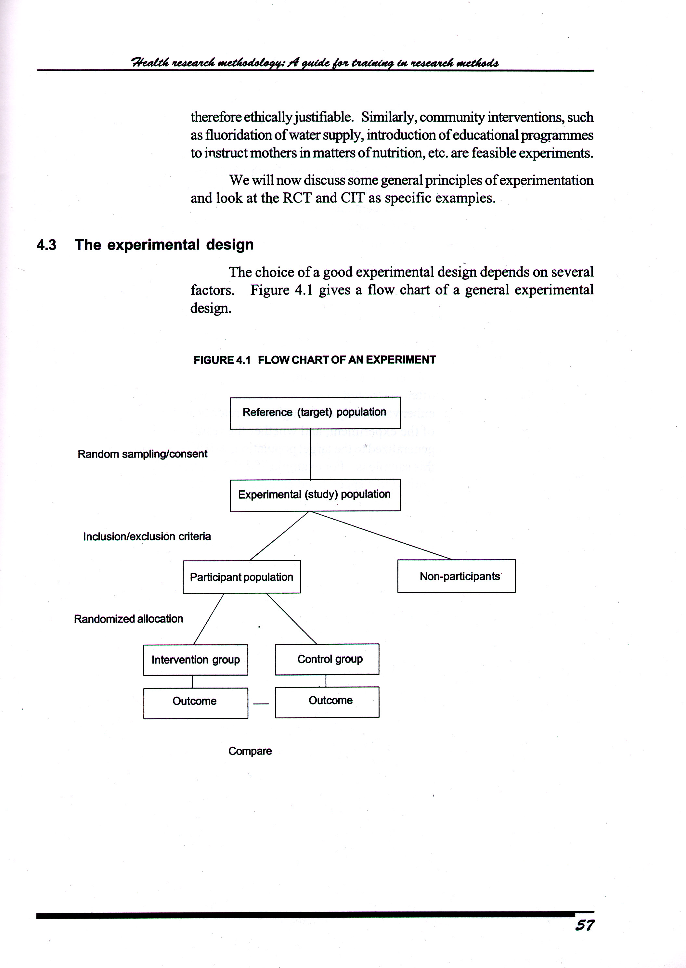
Flow chart of an experiment

Slide 73
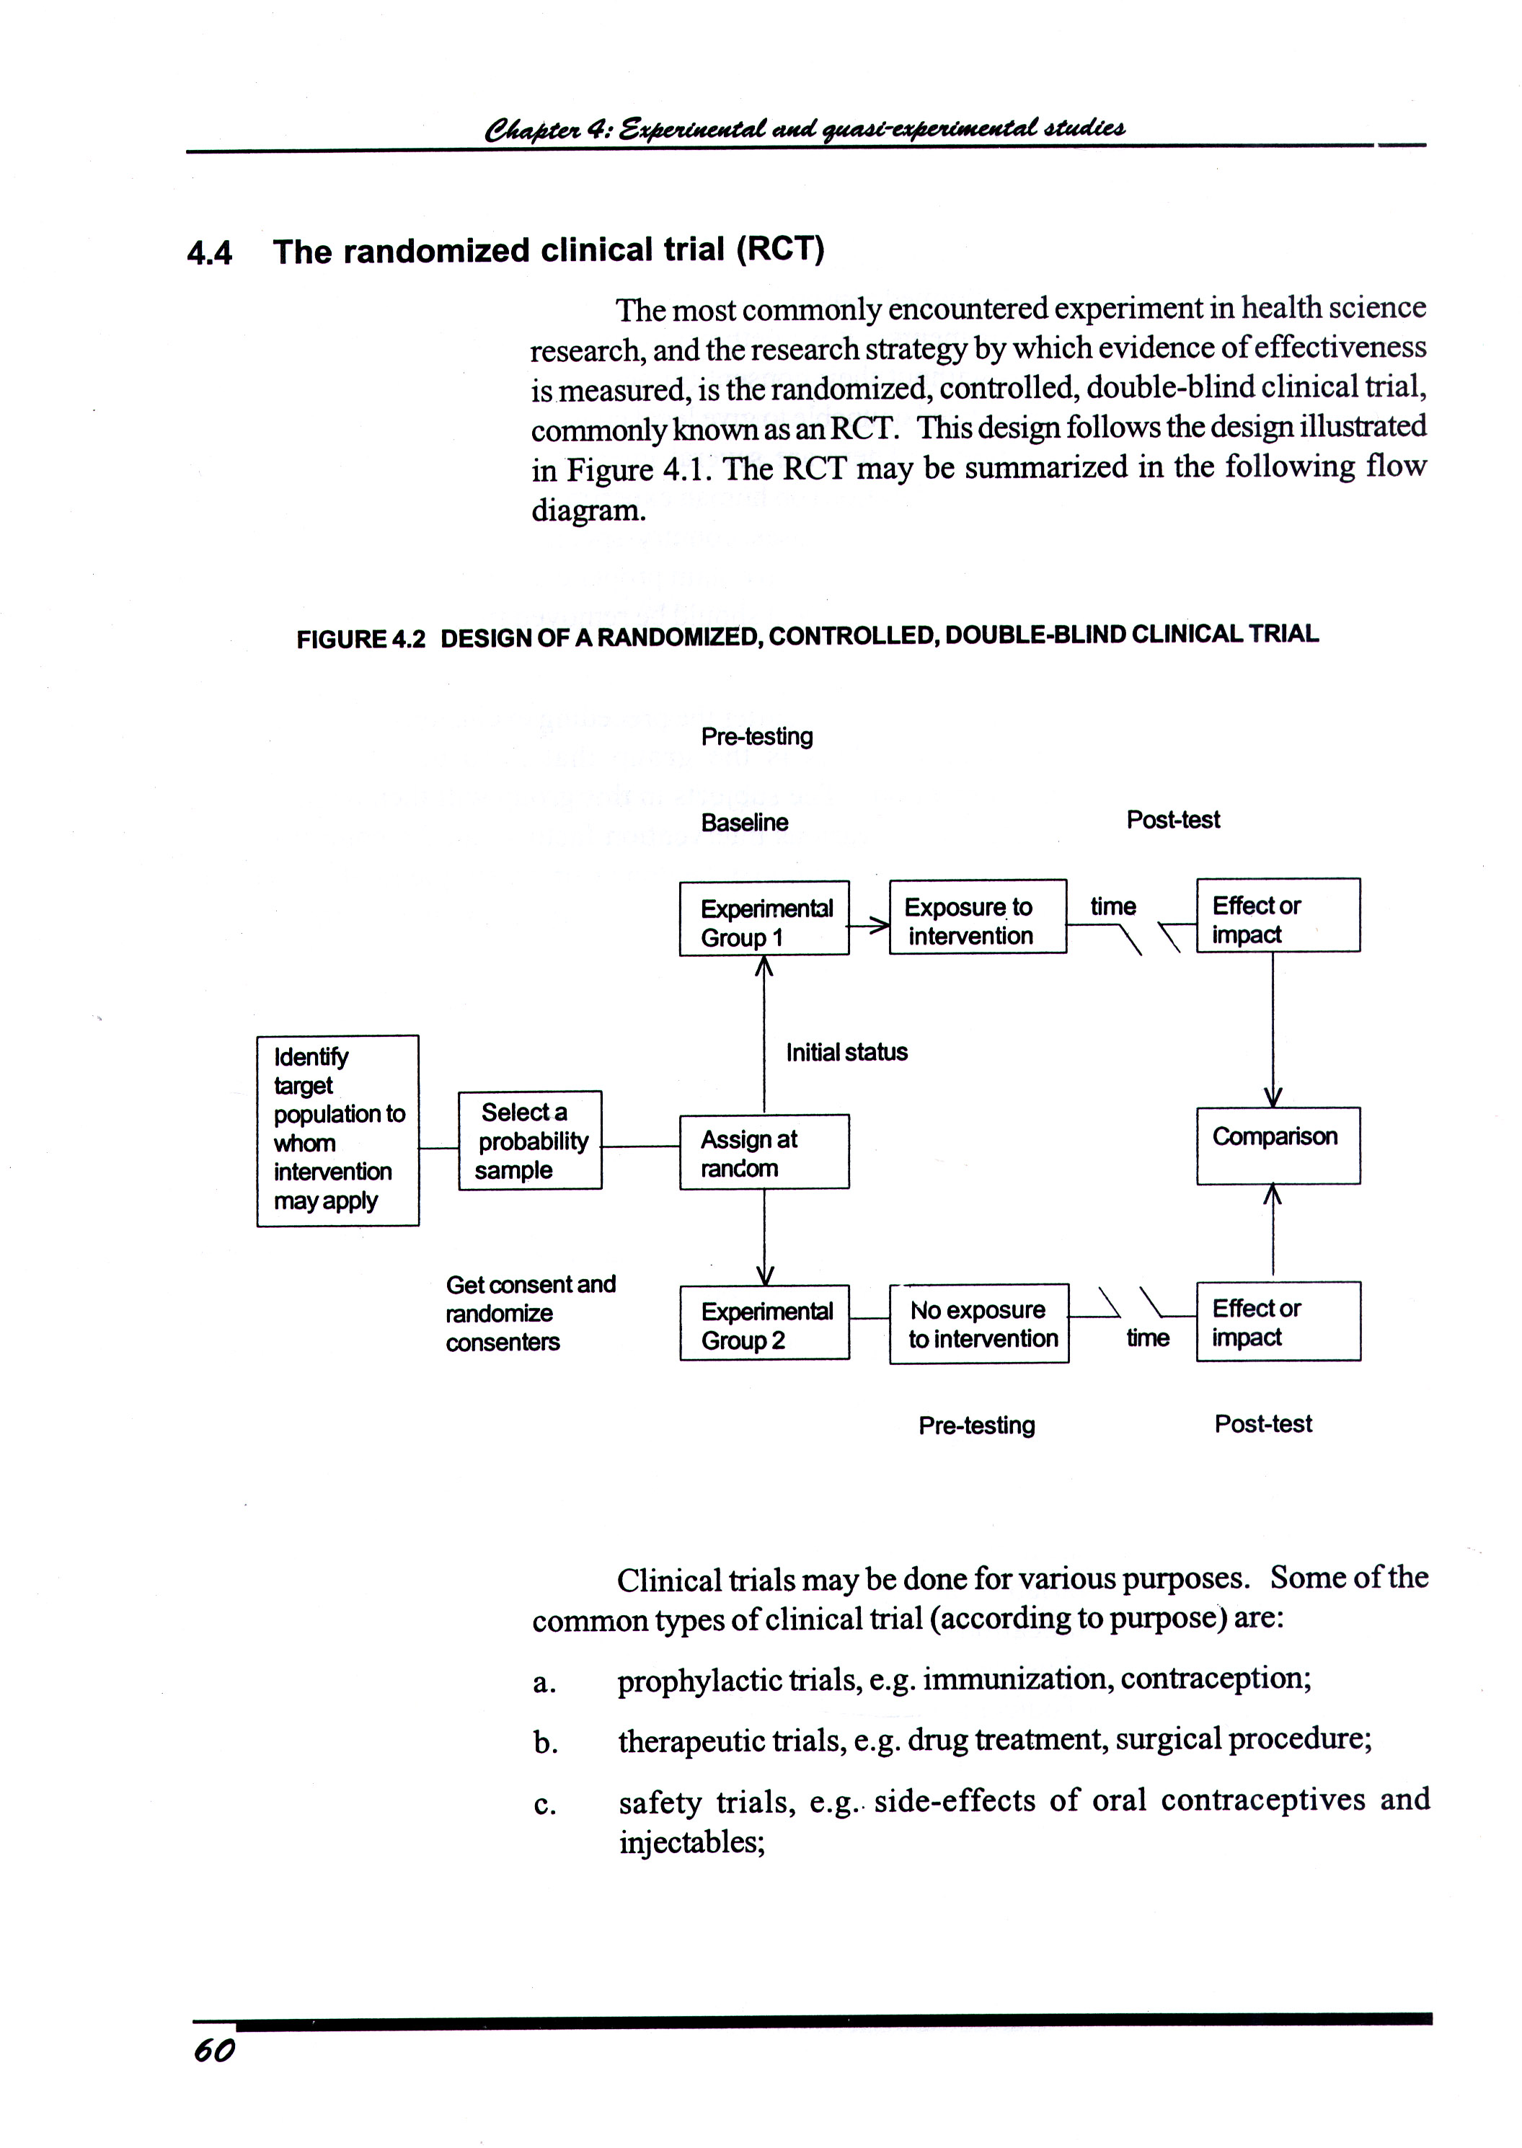
Design of a Randomized, Controlled, Double Blind Clinical Trial

Slide 74
Materials and Methods

Slide 75
Materials and Methods
 Study design
 Subject selection procedure
 Reason for selecting the experimental
design of the study
 Methods of measurement
 Statistical methods used for analytical
technique
Block II. Writing the article

Slide 76
Materials and Methods
Patients / Animals / Specimens
 Numbers
 How are they grouped (cases /controls)
 Criteria (inclusion/exclusion)
 Informed consent obtained
Block II. Writing the article

Slide 77
Methods
Provide the reader enough details so they can understand and replicate your research
Explain how you studied the problem, identify the procedures you followed, and order these chronologically where possible

Slide 78
Methods
Explain new methodology in detail; otherwise name the method and cite the previously published work
Include the frequency of observations, what types of data were recorded, etc.
Be precise in describing measurements and include errors of measurement or research design limits

Slide 79
Method (Cont.)
  Selection criteria
    -inclusion criteria
    -exclusion criteria
  Operational definition
  Grouping of study subjects (if applicable)
  Data collection technique
  Intervention

Slide 80
Method (Cont.)
all drugs and chemicals used should be Identified precisely , including generic name(s), dose(s) and route(s) of administration
Details about Randomization
Any losses to observation/drop out
Data processing, analysis including statistical analysis
Study plan with a flow chart
Time Table

Slide 81
Method (Cont.)
Quality control measures
Ethical clearance
Ethical implication
Consent of participants.
All should be described in past tense

Slide 82

Gerald had begun to think that his
methodology was too detailed.

Slide 83
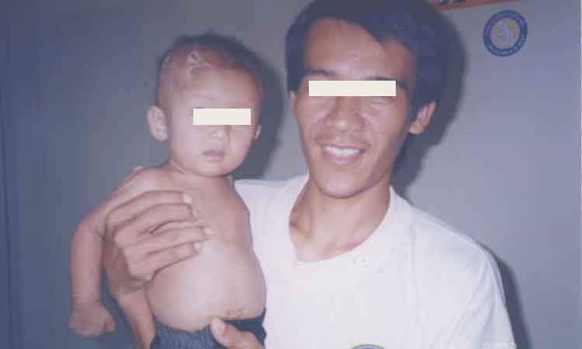
The patient has the right to refuse or withdraw to the extent permitted by law and to be informed of the medical consequences of his action
Privacy and Confidentiality should be strictly followed
Patients’ names, initials or hospital numbers, should not be used especially in illustrative materials

Slide 84
Example: Writing Methodology
Rituximab is a genetically engineered chimeric anti-CD20 monoclonal antibody that is approved for the treatment of relapsed or refractory, low-grade or follicular, CD20+ B-cell non-Hodgkin's lymphoma. CD20 is a B-cell surface antigen that is expressed only on pre-B and mature B cells. It is not present on stem cells and is lost before differentiation of B cells into plasma cells.
Block II. Writing the article

Slide 85
Example: Writing Methodology
Therefore, rituximab causes a selective transient depletion of the CD20+ B-cell subpopulation.⁷ To confirm the role of B cells in rheumatoid arthritis, we evaluated the effect of rituximab in patients with active rheumatoid arthritis in a multicenter, randomized, double-blind, controlled study.
Block II. Writing the article

Slide 86
Says what is known about the disease
Rheumatoid arthritis is a systemic autoimmune disease that affects approximately 1 percent of the adult population.¹ It is characterized by chronic inflammation in the synovial membrane of affected joints that ultimately leads to loss of daily function due to chronic pain and fatigue.
The majority of patients also have deterioration of cartilage and bone in the affected joints, which may eventually lead to permanent disability. Rheumatoid arthritis is associated with increased morbidity and mortality.²
Highlights the importance of a fact
Block II. Writing the article

Slide 87
Blank in the knowledge
Although the precise pathogenesis of rheumatoid arthritis remains unclear, it has been postulated that multiple exogenous or endogenous antigenic triggers, or both, act in the presence of a background genetic predisposition to initiate a self-perpetuating series of autoimmune responses in the synovial compartment.^{3,4} Many cell populations, including monocytes, macrophages, B cells, T cells, endothelial cells, and fibroblasts, participate in the ongoing inflammatory process.³ The precise contribution of B cells to the immunopathogenesis of rheumatoid arthritis is not fully understood, although a number of mechanisms have been proposed.^{4,5,6} However, strong evidence for a critical role of B cells in rheumatoid arthritis came from a small open-label study of rituximab in combination with cyclophosphamide and corticosteroids.⁷
Transition to the “so...”
Block II. Writing the article

Slide 88
Rituximab is a genetically engineered chimeric anti-CD20 monoclonal antibody that is approved for the treatment of relapsed or refractory, low-grade or follicular, CD20+ B-cell non-Hodgkin's lymphoma. CD20 is a B-cell surface antigen that is expressed only on pre-B and mature B cells. It is not present on stem cells and is lost before differentiation of B cells into plasma cells. Therefore, rituximab causes a selective transient depletion of the CD20+ B-cell subpopulation.⁷ To confirm the role of B cells in rheumatoid arthritis, we evaluated the effect of rituximab in patients with active rheumatoid arthritis in a multicenter, randomized, double-blind, controlled study
So...What we did?
Block II. Writing the article

Slide 89
“We studied the patients with the characteristics A and excluded those with the item B. We measured C, D and F. We defined F as C+D. To make the measurements we used the device ABC. To study if there were statistical difference between the patients, we did the test X...”
Block II. Writing the article

Slide 90
Inclusion criteria
Definitions
Patients
Patients were recruited from 26 rheumatology centers in 11 countries (Australia, Canada, Israel, and 8 European countries). Eligible patients were at least 21 years of age, fulfilled the revised 1987 American Rheumatism Association criteria,¹ and had active disease despite treatment with at least 10 mg of methotrexate per week. Active disease was defined by the presence of at least eight swollen and eight tender joints and at least two of the following: a serum C-reactive protein level of at least 15 mg per liter, an erythrocyte sedimentation rate of at least 28 mm per hour, or morning stiffness lasting longer than 45 minutes. In addition, eligible patients were seropositive for rheumatoid factor, as defined by a plasma rheumatoid factor level of at least 20 IU per milliliter.
Patients were excluded if they had an autoimmune disease other than rheumatoid arthritis (except concurrent Sjögren's syndrome), American Rheumatism Association functional class IV disease,).
Exclusion criteria
Block II. Writing the article

Slide 91
What was done?
Study Protocol
Therapy with Patients were randomly assigned to receive one of four treatments: oral methotrexate at a dose of 10 mg or more per week plus placebos for rituximab and cyclophosphamide (control group), rituximab plus placebos for methotrexate and cyclophosphamide, rituximab plus cyclophosphamide in an intravenous infusion of 750 mg on days 3 and 17 plus placebo for methotrexate, and rituximab plus methotrexate at a dose of 10 mg or more a week plus placebo for cyclophosphamide. In all three groups that received rituximab (MabThera, Roche; Rituxan, Genentech and IDEC Pharmaceuticals), rituximab was administered as a 1000-mg intravenous infusion on days 1 and 15. Investigators and patients remained blinded to the assigned study medications.
Clinical assessments were performed at baseline (day 1) and at weeks 12, 16, 20, and 24 according to the American College of
Block II. Writing the article

Slide 92
What instrument was used?
Rheumatology (ACR) core set of disease-activity measures. These consisted of a count of swollen joints (66 joints evaluated),... and laboratory evaluation of acute-phase reactants (serum C-reactive protein level and erythrocyte sedimentation rate).
Laboratory assessments (including complete blood counts and serum biochemical analyses) were performed at screening (three weeks before baseline), on days 1, 3, 15, and 17, and at weeks 4, 8, 12, 16, 20, and 24. ...
Definitions
Block II. Writing the article

Slide 93
What do we study-measure?
Clinical Outcome Measures
The primary end point of the study was the proportion of patients with an ACR 50 response at week 24. ...and the value for one acute-phase reactant (either serum C-reactive protein level or erythrocyte sedimentation rate).⁹
Secondary outcomes included ACR 20 and ACR 70 responses (20 percent and 70 percent improvement, respectively, according to the ACR criteria), ...¹⁰ and the response according to the criteria of the European League against Rheumatism (EULAR response).¹¹
Block II. Writing the article

Slide 94
Statistics
Clearly mention the statistical methods used for appropriate verification of reported results.
Block II. Writing the article

Slide 95
What tools we use to detect differences?
Statistical Analysis
Sample-size calculations were based on the assumption..... On the basis of these assumptions and with the use of Fisher's exact test with a two-sided significance level of 0.05, we calculated that a sample of 40 patients per treatment group would provide the study with 82 percent power to detect a difference between the two proportions.
How the assessed parameters were statistically treated
Block II. Writing the article

Slide 96
Results

Slide 97
Results
Objectively present your findings, and explain what was found
Show that your new results are contributing to the body of scientific knowledge
Follow a logical sequence based on the tables and figures presenting the findings to answer the question or hypothesis
Figures should have a brief description (a legend), providing the reader sufficient information to know how the data were produced

Slide 98
Results
 Communication of facts, measurements,
and observations gathered by the author
 Start with the results that are easier to
interpret
 Results should be set out in tables,
graphs, figures, charts, findings summary
 Do not duplicate illustrations
Block II. Writing the article

Slide 99
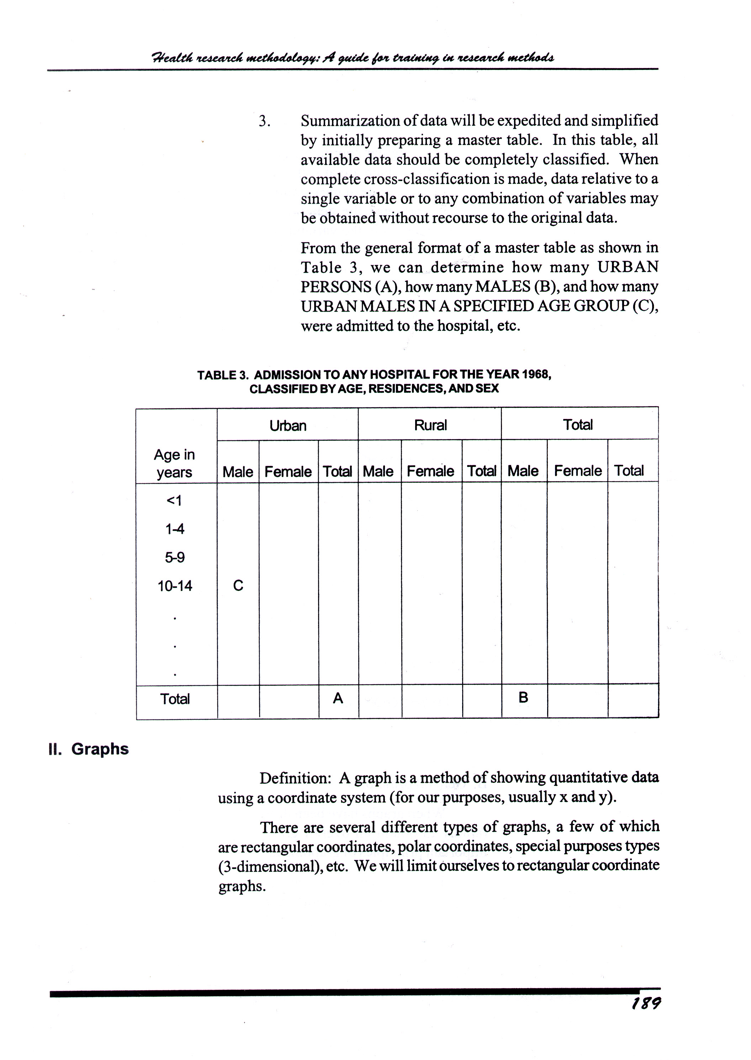
Tables

Slide 100
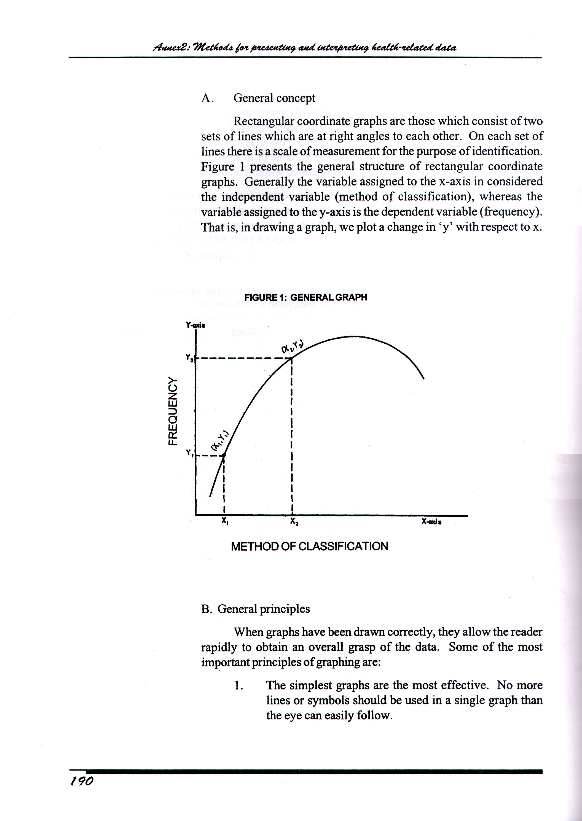
Graphs

Slide 101
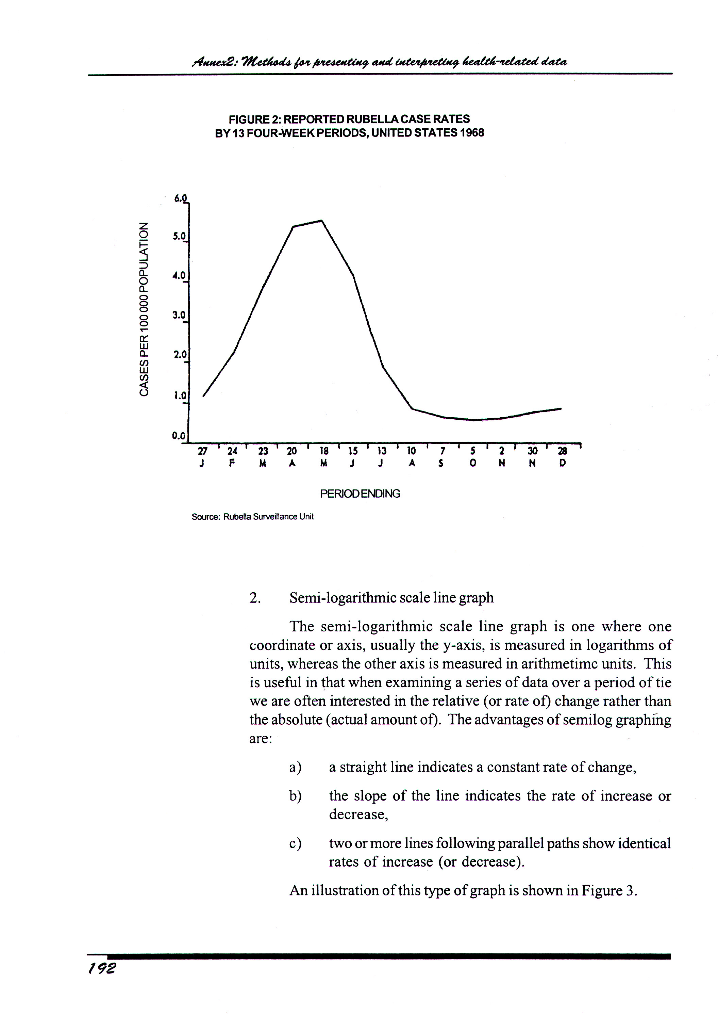
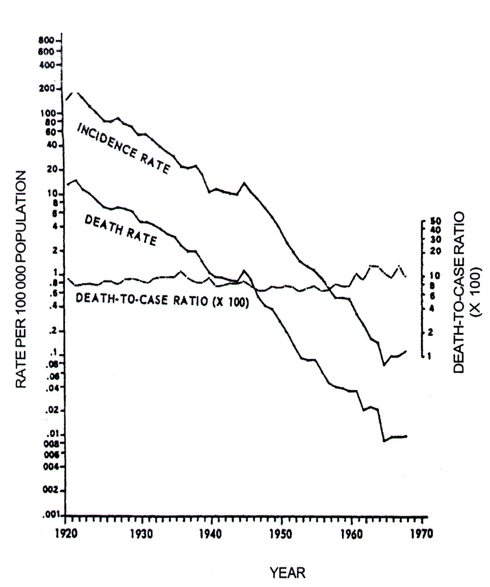
Graphs

Slide 102
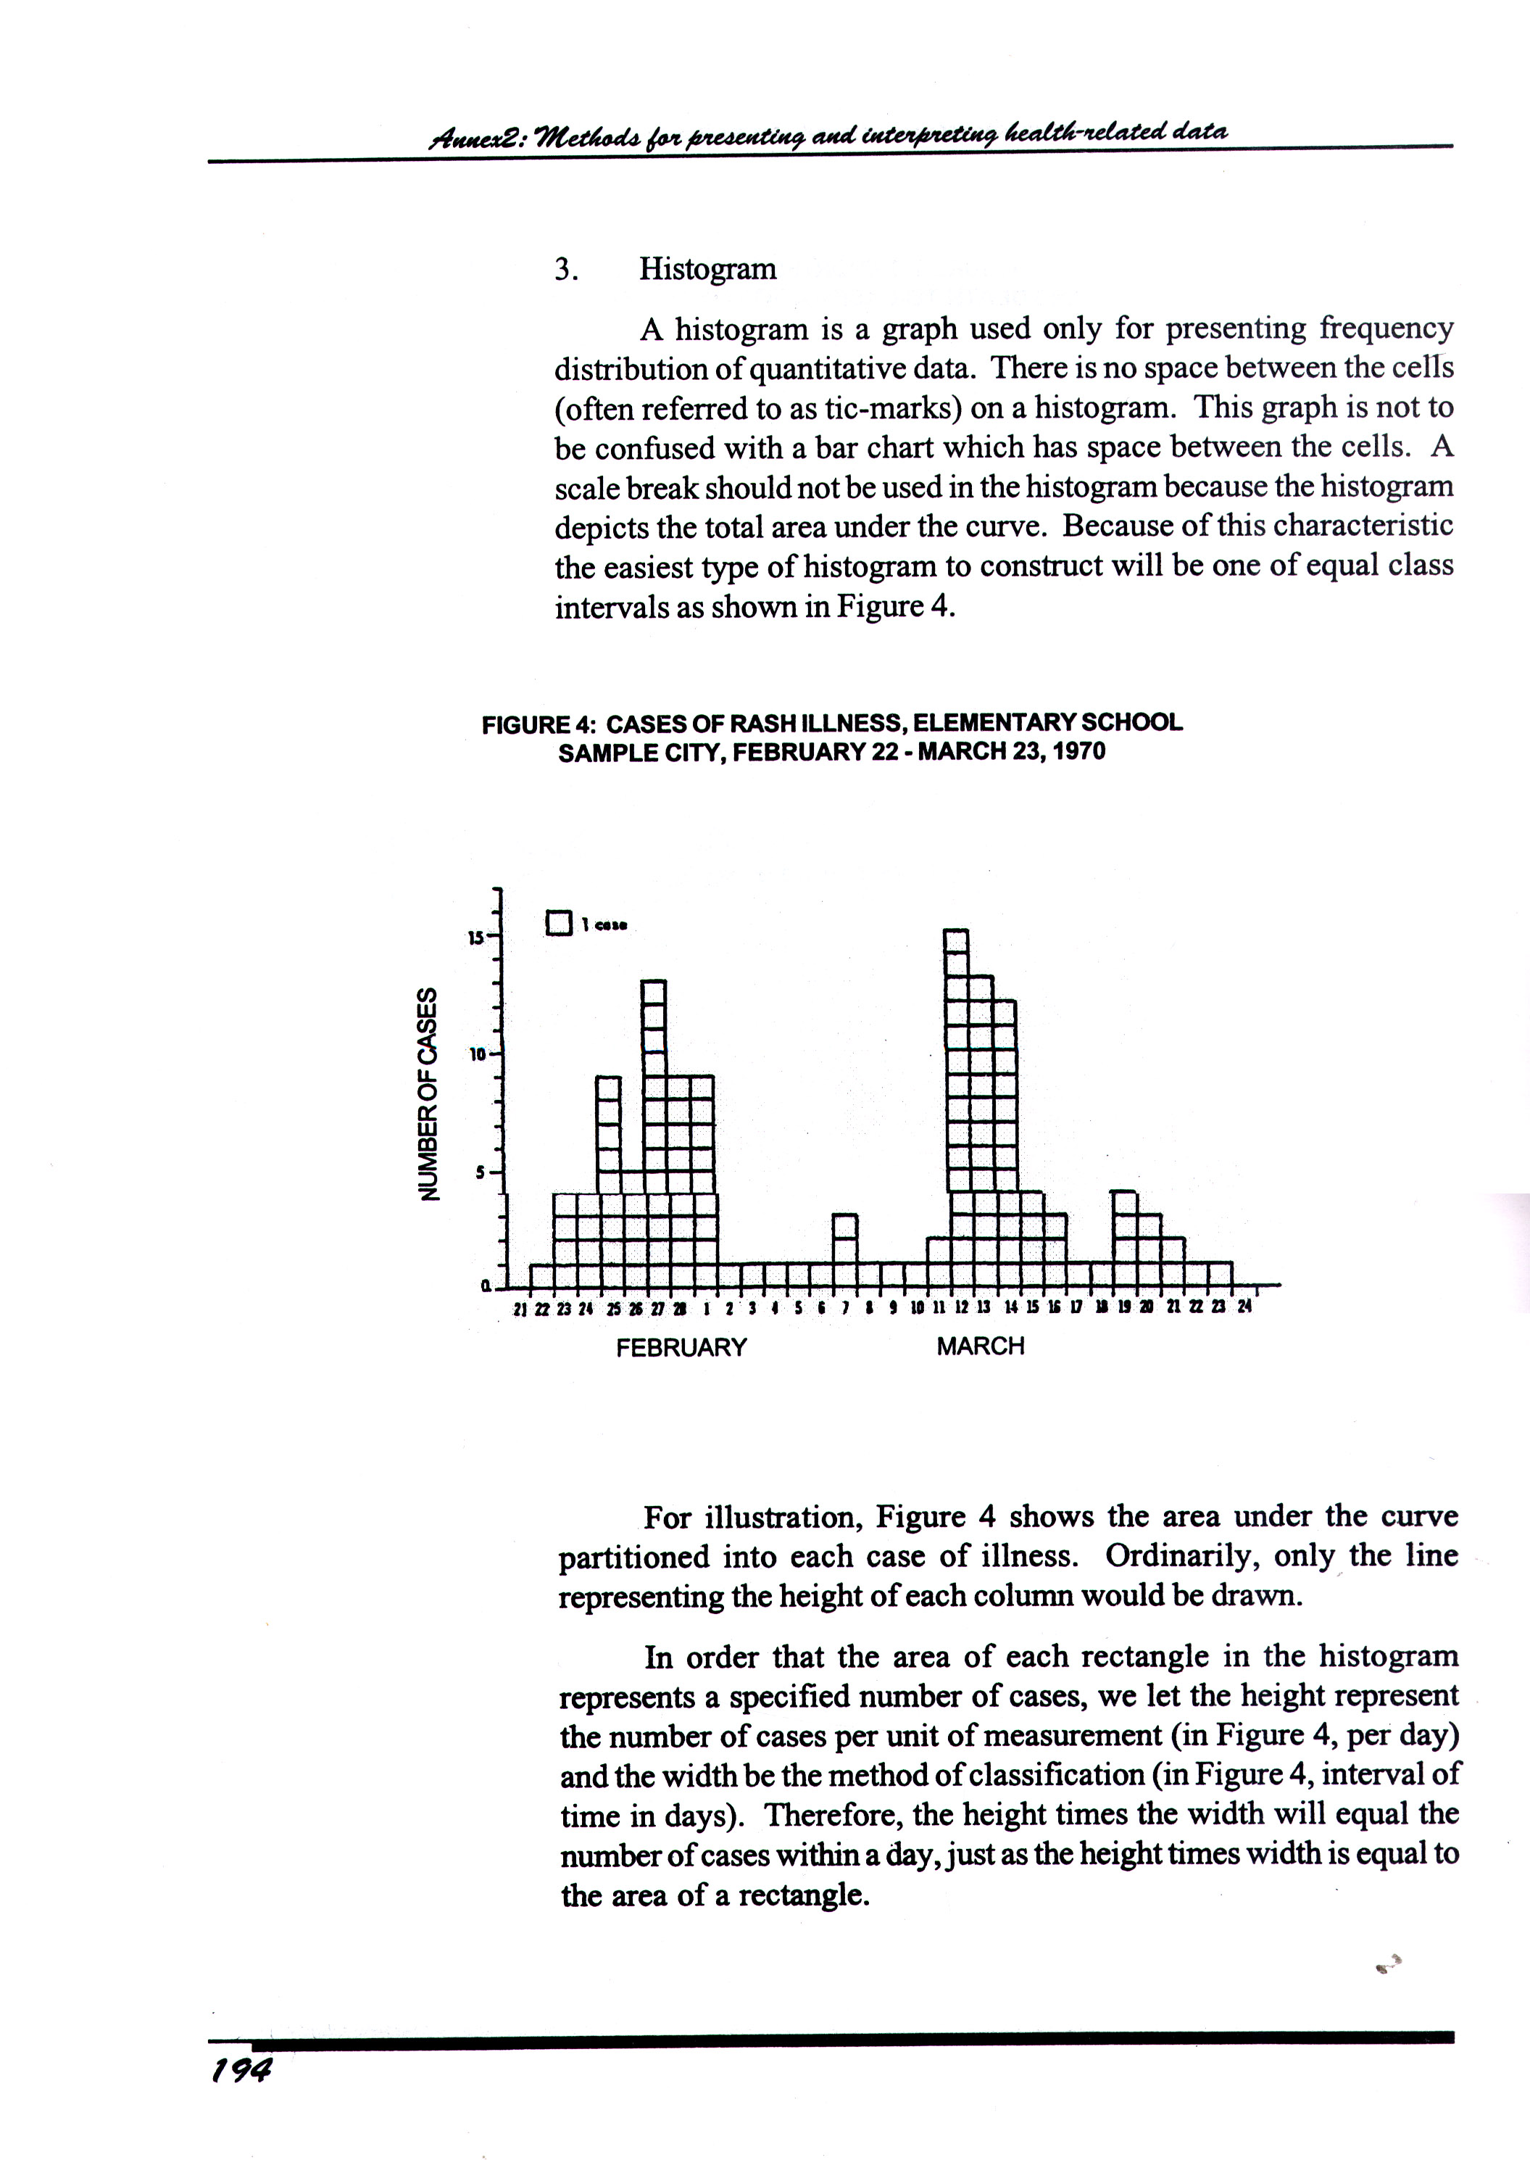
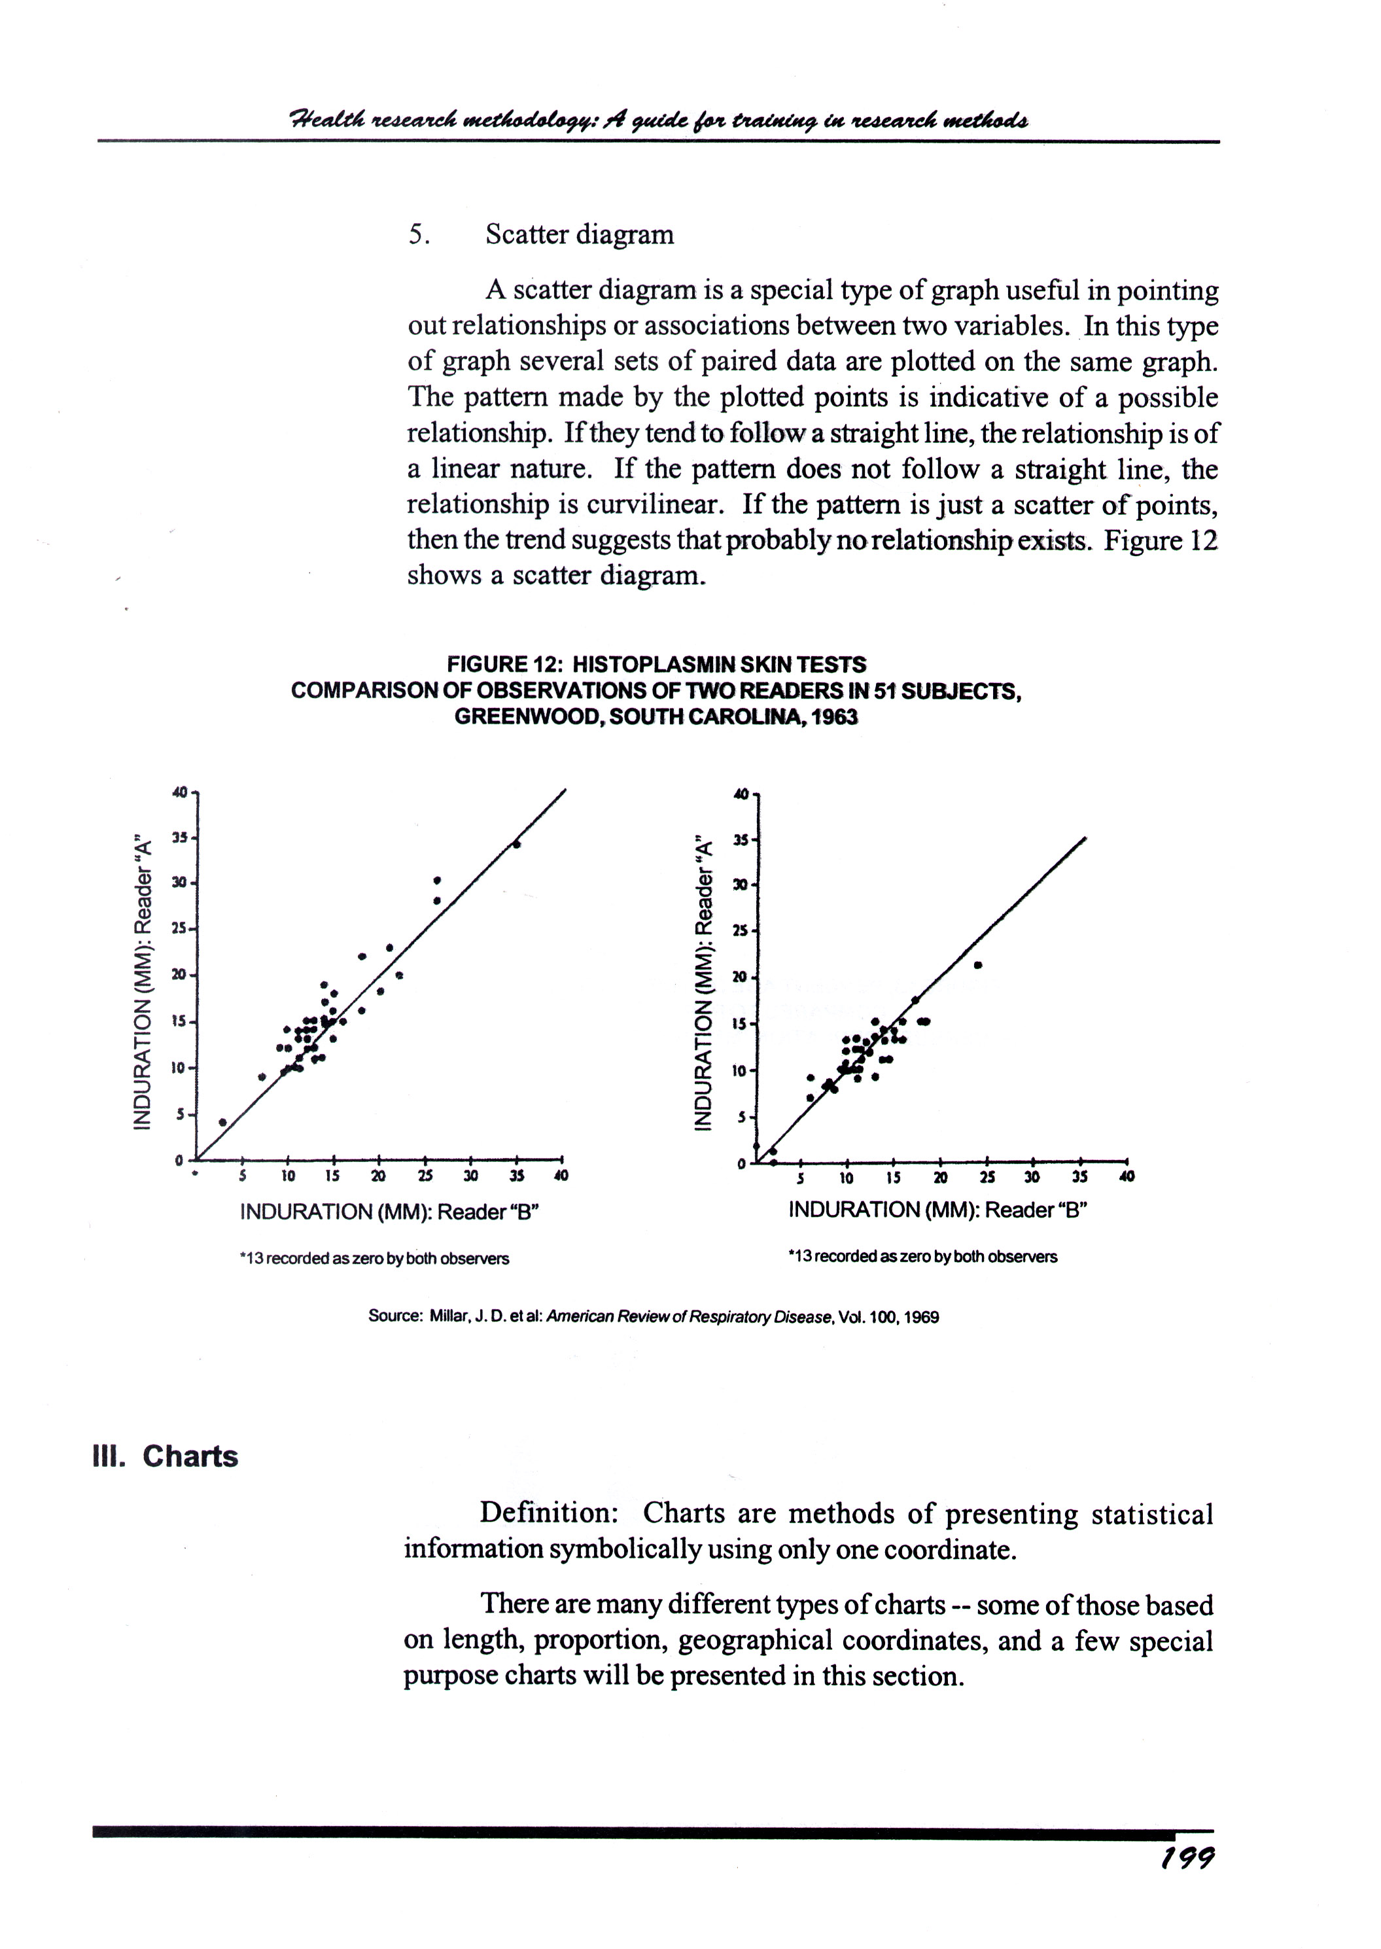
Graphs

Slide 103
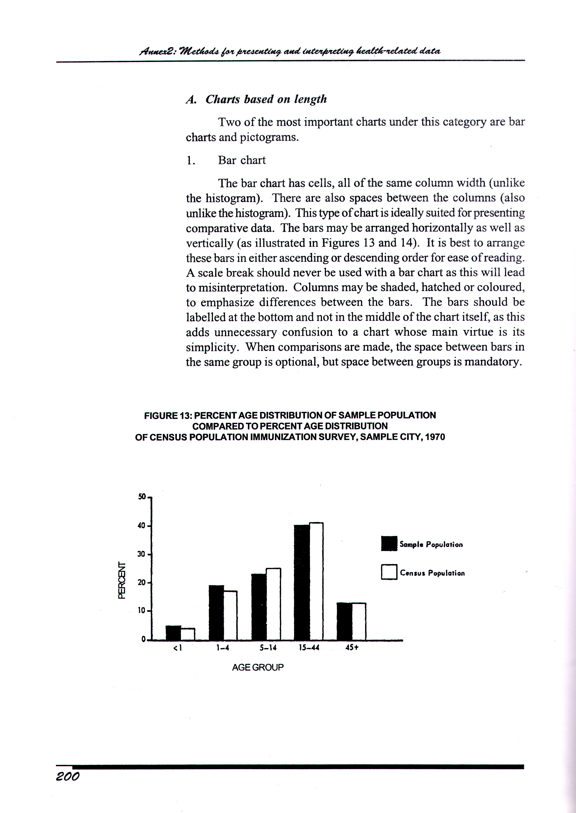
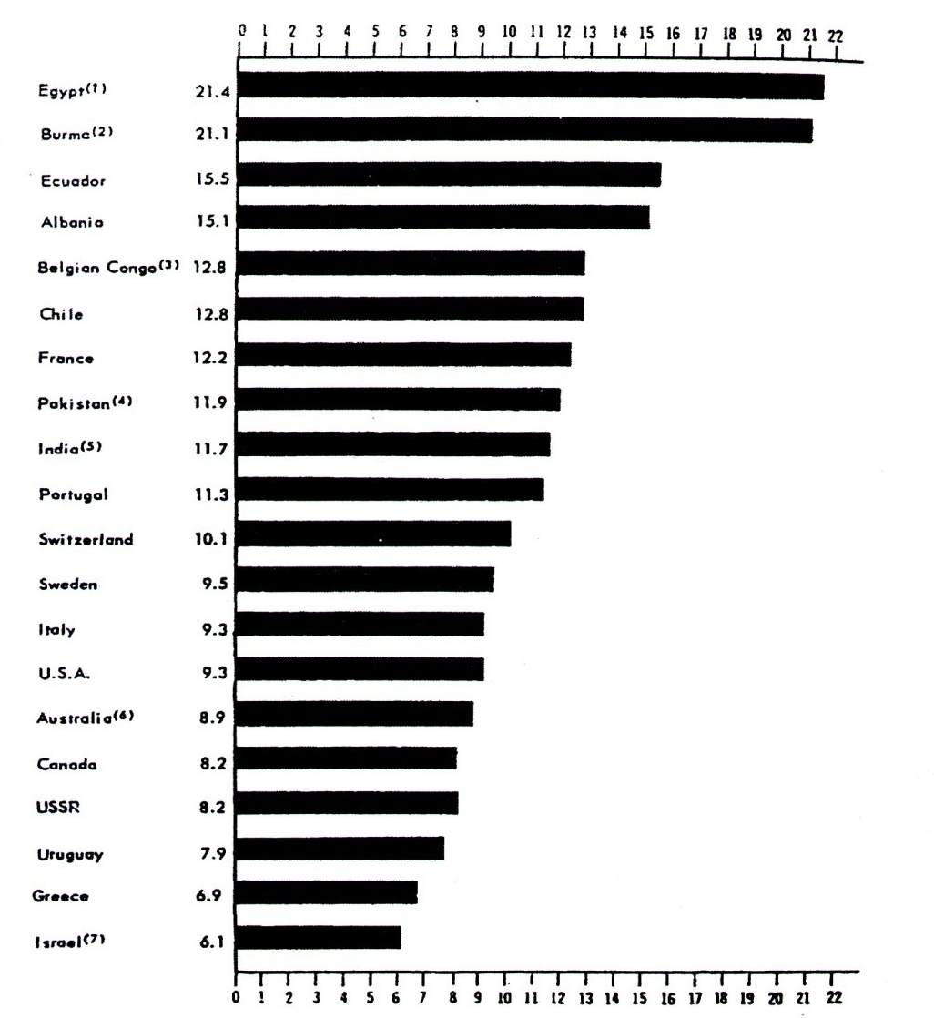
Charts

Slide 104
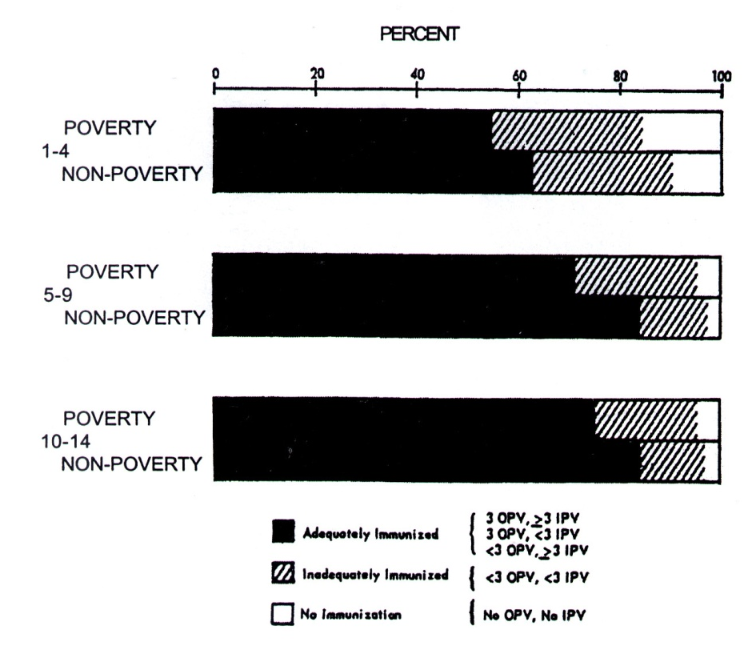
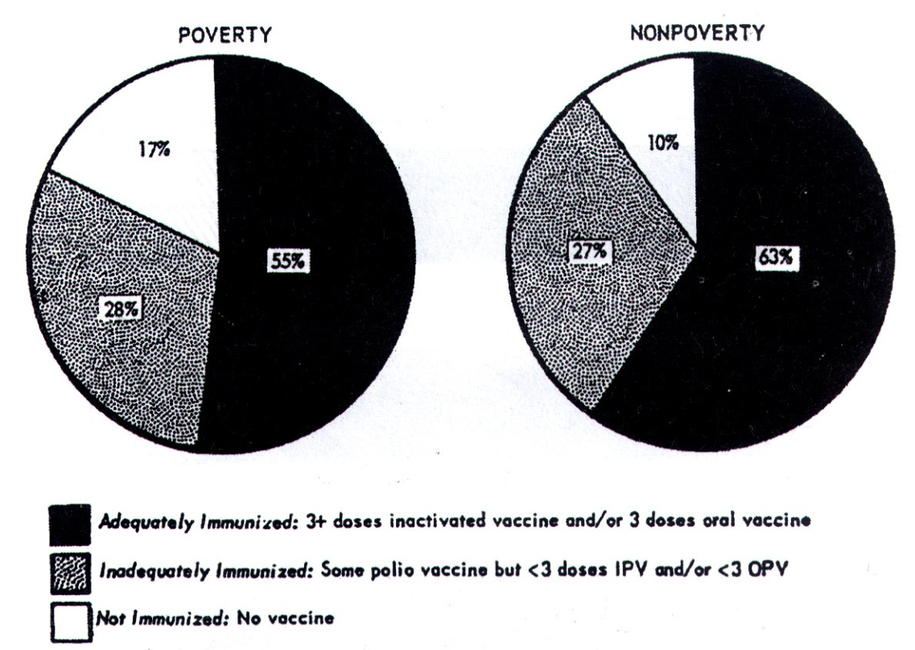
Charts

Slide 105

Charts

Slide 106
Results
 Short and concise paragraph
 Answers the questions on the section Material and Method
 We might write it in the same order than it was in
the section Material and Method
 Never try to explain the results or take any conclusion
Block II. Writing the article

Slide 107
Results
“N patients were studed. A were included. B were excluded for having 1, the demographical features were D, E and F. With respect to the parameter A the result was 1, with respect to B, the result was 2. With respect to C, the result was D....”
Block II. Writing the article

Slide 108
Results
Of the 4164 hospital admissions sampled from the participating hospitals, 3745 patient charts (89.9%) were eligible for a full screening by the stage 1 reviewers (Fig. 1). Of these, 1527 (40.8%) were assessed as positive for 1 or more screening criteria (Table 1)...
Included & excluded
Block II. Writing the article

Slide 109
Results
Enumerates results
...the physician reviewers identified a total of 1133 injuries or complications in 858 charts. In 401 (46.7%) of these charts the injuries resulted in death, disability at the time of discharge or prolonged hospital stay. In 255 of the charts one or more of the AEs were rated 4 or higher on the 6-point causation scale (Box 1).
Block II. Writing the article

Slide 110
Discussion/Conclusion
Describe what your results mean in context of what was already known about the subject
Indicate how the results relate to expectations and to the literature previously cited

Slide 111
Discussion

Slide 112
Discussion/Conclusion
Explain how the research has moved the body of scientific knowledge forward
Do not extend your conclusions beyond what is directly supported by your results - avoid undue speculation
Outline the next steps for further study

Slide 113
Discusion
 Highlights the importance of the subject (it may
start with a short review)
 Meaning - significance of the work
 Gives an explanation of the results
 Result - comparation-explanation
 A review of the state of the art can be done
 Critic of the study - Limitations/apologies
 Comparisons of works of others
Block II. Writing the article

Slide 114
Discusion
 Final paragraph in which the message
of the article is firmly stated.
 Point out where further gaps in
knowledge could usefully be filled
instead of "further research is
needed".
Block II. Writing the article

Slide 115
Discussion
State the answer to the research question with supporting evidence
compare main findings with other published findings
Provide possible explanation

Slide 116
Discussion
Implication of the findings
  The results are evaluated and interpreted with respect to the research question and hypothesis
  Emphasize the new and important aspects of the study in logical sequence
Data or other material given in the introduction or the results section should not be repeated

Slide 117
Discussion
Limitations of the study should be stated
It should be in separate paragraph but continuation
The discussion should end with restating the answers and indicating the importance of the answers .

Slide 118
Example: Discusion
“ A is a very important parameter to determine B, as other studies have shown. Ours showed that A had the characteristics 1, 2 and 3, which is similar to other studies carried out to this respect. Nevertheless, It had the characteristic 4, which was different. We think that it may be due to...”
Block II. Writing the article

Slide 119
Incident rates of endometrial cancer vary more than 10-fold worldwide.¹⁸ In addition to host susceptibility, dietary factors may play an important role...
In our study population, the average intake of isoflavones from soya food was about 25 times that reported in a Western population....¹¹ Some of these previous studies were not specifically designed to investigate the role of soya food...The sample sizes of the previous studies were relatively small, which limited the statistical power ...This population based case-control study... indicates that usual consumption of soya foods by adults, ... is associated with a significantly reduced risk of endometrial cancer....
Results of our study
Review
Conclusion/Hypotesis
Comparison with respect to other studies
Block II. Writing the article

Slide 120
This population based case-control study... indicates that usual consumption of soya foods by adults, ... is associated with a significantly reduced risk of endometrial cancer....
Although not all associations were statistically significant in subgroup analyses, the different measurements produced similar results.
...Studies with measured oestrogen concentrations are needed to better understand the joint effect of soya and endogenous oestrogen on endometrial cancer risk.
Conclusion/Hypotesis
Limitations of the study
Block II. Writing the article

Slide 121
References

Slide 122
References
Whenever you draw upon previously published work, you must acknowledge the source
Any information not from your experiment and not ‘common knowledge’ should be recognized by a citation
How references are presented varies considerably - refer to notes for authors for the specific journal
Avoid references that are difficult to find
Avoid listing related references that were not important to the study

Slide 123
Harvard Reference Style
Uses the author's name and date of publication in the body of the text, and the bibliography is given alphabetically by author
  Adams, A.B. (1983a) Article title: subtitle. Journal Title 46 (Suppl. 2), 617-619
  Adams, A.B. (1983b) Book Title. Publisher, New York.
  Bennett, W.P., Hoskins, M.A., Brady, F.P. et al. (1993) Article title. Journal Title 334 , 31-35.

Slide 124
Example :
Chen X, Ba Y, Ma L, Cai X, Yin Y, Wang K et al., (2008).
Characterization of microRNAs in serum:a novel class of biomarkers for diagnosis of cancer and diseases. Cell Research, 18(10), 997-1006

Slide 125
Vancouver Reference Style
Uses a number series to indicate references; bibliographies list these in numerical order as they appear in the text
  1. Adams, A.B. (1983) Article title: subtitle. Journal Title 46 (Suppl. 2), 617-619.
  2. Lessells, D.E. (1989) Chapter title. In: Arnold, J.R. & Davies, G.H.B. (eds.) Book Title , 3rd edn. Blackwell Scientific Publications, Oxford, pp. 32-68.
  3. Bennett, W.P., Hoskins, M.A., Brady, F.P. et al. (1993) Article title. Journal Title 334 , 31-35.

Slide 126
Example:
Kumuda A, Khan ME, Hazra A . Increasing appropriate complementary feeding in rural uttar prodesh. THE journal of Family welfare 2010 ;56:51-56
Braverman AC, Diseases of the Aorta. In: Mann DL, Zipes DP, Libby P, editors. Braunwald’s Heart Diseases: Textbook of Cardiovascular Medicine, 10th ed. Philadelphia PA: Elsevier Saunders;2015 p 1277-1311

Slide 127
Chapter in a Book
If you need to quote or cite a particular chapter of a book and it has a separate author you can list it as follows:
Author(Connell PRO). Chapter name(The Vermiform Appendix). In: editor name(Williams NS). Name of the book(Short Practice of Surgery). Edition(26th ). Publisher(Taylor & Francis), Place of publication(Tokyo). Year(2013). Page number(Pp1199-1214).
Connel PRO. The Vermiform Appendix. In: Williams NS. Short Practice of Surgery. 26th Ed. Taylor & Francis. Tokyo. 2013. Pp 1199-1214.

Slide 128
Citation from Internet
Mobile Health News [Internet]. C2010 [cited 2010 july18].Available at :http:// mobile health news.com/850/the-real-top-iphone.
Competency based Medical education. http://www.google.com/med edu.
[Accessed on March 15, 2011].

Slide 129
Prototype reference writing (Modified Vancouver Method)
Surname first with abbreviation of other’s name i.e. Islam Q T
 Five authors are entitled to cite examples
 Name of article:
 Name of Journal (abbr)
 Year;
 Volume:
 Issue ( )
 Page no
Example:
Wilson PW, Garrison RJ, Castelli WP, Feinleib M, McNamara PM. Prevalence of coronary heart disease in the Framingham Offspring study: role of lipoprotein cholesterols. Am J Cardiol 1980;46:649-54.
Block II. Writing the article

Slide 130
Citation Styles
1. Citation for material from an editorial: Glasziou P. Which
methods for bedside Bayes? [Editorial]. ACP J Club. 2001 Nov-Dec;
135:A-11-2
2. Citation for material taken from a structured abstract,
written without attribution by a staff member: Tissue-
plasminogen activator reduce mortality rates compared with
streptokinase for acute MI [Abstract]. ACP J Club. 1997 Jan-Feb; 126:3.
Block II. Writing the article

Slide 131
Citation Styles
3. Citation for material taken from a commentary to an article:
Meisner JS. Diastolic dysfuction was predictive of all-cause
mortality [Comment]. ACP J Club. 2003 Sep-Oct; 139:53.
4. Citation for material taken from a letter: Peterson D. Numbers
needed to treat derived from meta-analysis: a word of caution [Letter].
ACP J Club. 2003 Jul-Aug; 139:A15; author reply A15.
Block II. Writing the article

Slide 132

Jane suddenly realised that her reference
list had too many self citations…

Slide 133
Appendix

Slide 134
Appendices
Is a supplementary section that contain materials related to the text but not suitable to include in it
The pages must be numbered consecutively and have appropriate title
Should include copies of
  Blank data collection form
  Informed consent form
  Ethical clearance of IRB

Slide 135
Appendices
  Correspondence /Permission from relevant authority e.g certificate from head of the laboratory where tests being done
  Quality assurance strategy
  Qualitative study-Transcripts etc

Slide 136
Summaries/Examples of Styles
International Committee of Medical Journal Editors Uniform Requirements for Manuscripts Submitted to Biomedical Journals: Sample References
  http://www.nlm.nih.gov/bsd/uniform_requirements.html
How to Cite References/Vancouver Style, Murdoch University, Australia
  http://wwwlib.murdoch.edu.au/find/citation/vancouver.html
Blackwell Publishing Online/References
  http://www.blackwellpublishing.com/authors/reference_text.asp
BMA Reference Styles
  http://www.bma.org.uk/ap.nsf/Content/LIBReferenceStyles

Slide 137
Clinical case presentation

Slide 138
And if it is a Clinical Case?
 Introduction
 Clinical case
 Conclusions
Block II. Writing the article

Slide 139
Introduction: Usually based on rarity
Clinical case:
“A N yr-old (wo)man was admitted for a feature of....his/her clinical history was....in the physical examination…the laboratory findings showed…the radiological techniques were…To exclude a…the A test was asked, with the result 1. With the suspect of a B, test B, was asked….Thus, we diagnosed the pathology P”
Block II. Writing the article

Slide 140
A 28-year-old man was admitted to the hospital because of abdominal pain and fever. The patient had been well until 10 days earlier, when mild epigastric pain developed. Two days before admission...
On physical examination, the patient did not appear to be in severe pain, and there was...
The urine was positive (+) for ketones; the sediment contained....
...Radiographs of the abdomen obtained both while the patient was supine and while he was upright showed ..... A cystic mass, 1.5 cm in diameter, was contiguous with the head and neck of the pancreas. The remainder of the pancreas was unremarkable
Oral intake was stopped. The patient was given fluid and electrolytes as well as ranitidine, metronidazole, ampicillin, minidose heparin, and morphine, which was administered...

Slide 141
The article has been written
And now....?
 Be sure it has the conditions required by the
journal (length, structure....)
 Submit it to the editor
 Undergo the review process

Slide 142
Article submission

Slide 143
Article Submission
Select your journal carefully
Read the aims and scope
Think about your target audience and the level of your work – do you have a realistic chance of being accepted?
Follow the guidelines in the notes for authors and include everything they ask – it makes the editor’s job easier…
Articles should not be submitted to more than one journal at a time
See: Instructions to Authors in Health Sciences
http://mulford.mco.edu/instr/

Slide 144
Online Submission
Many publishers now offer a completely electronic submission process
Article is submitted online and all of the review procedure also happens online
Speeds up the editorial process
Is invaluable for authors in low-income countries

Slide 145
Author Priorities for Journal Selection (Elsevier)
Key (Determining) factors
  Impact Factor
  Reputation
  Access to the target audience
  Overall editorial standard
  Publication speed
  International coverage
  Open Access or HINARI participating publisher
Marginal (Qualifying) factors
  Experience as a referee
  Track record
  Quality and colour illustrations
  Service elements

Slide 146
Author Priorities for Journal Selection (INASP)
Quality / prestige
Collection / specialisation
Habit / previous publication
Speed / time delay

Slide 147
Writing the first page
 It is a cover with the name of the article
 Names of the authors and the institution
 All the authors should sign
 Name and contact address of the principal
author should be at the bottom

Slide 148
Presentation letter
Dear Dr….:
“Enclosed are two complete copies of a manuscript by ….and…. Titled “…….” which is going to be submitted for possible publication in the “::::::::” section of the “(name of the journal”
This manuscript is new, is not being considered elsewhere and reports new findings that extends results we reported earlier in “(name of the Journal)”. An abstract of this manuscript was presented earlier ( write Congress)
Sincerely yours
Author A Author B Author C Author D

Slide 149
After Submission
Most journal editors will make an initial decision on a paper - to review or to reject
Most editors appoint two referees
Refereeing speed varies tremendously between journals
Authors should receive a decision of Accept, Accept with Revision (Minor or Major), or Reject
If a paper is rejected, most editors will write to you explaining their decision
After rejection, authors have the option of submitting the paper to another journal - editor’s suggestions should be addressed

Slide 150
Overview of Peer Review Process
Paper Submitted
Notification to Author
Confirmation of Receipt
Revise
Accept
Initial Decision by Editor
Revision Received
Rejection
Decide to Review
Revision Checked
Assign Reviewers
Reviewers Accept Invite
Reviews Completed
Paper sent to Publisher
Revise
Accept
Reject

Slide 151
Publishing Tips
Editors and reviewers are looking for original and innovative research that will add to the field of study; keys are:
  For research-based papers, ensure that you have enough numbers to justify sound statistical conclusions
  For a larger study, it may be better to produce one important research paper, rather than a number of average incremental papers

Slide 152
Aknowledgement

Slide 153
Acknowledgment
Is used to express author’s professional and personal indebt ness.
the use of “person” should be consistent. If the student begin with reference to “the author” should continue to use third person throughout

Slide 154
Acknowledgment
all contributors who do not meet the criteria for authorship, such as a person who provided purely technical help, writing assistance, or a department chair who provided only general support should be acknowledged.
Financial and material support should also be acknowledged.

Slide 155
Take Home message

Slide 156
Take home message
With a little planning, perseverance and practice we can make the medical literature not only palatable but downright digestible

Slide 157
Take home message
Write only when you are fully prepare to write
Think carefully about your message
 Convey only one message and not more than two in one article

Slide 158
Take home message
Think critically if your message is new and original
 Consult statistician for planning the study and statistical analysis and evaluation
 Each journal has its own style and instruction to authors

